Slide 1
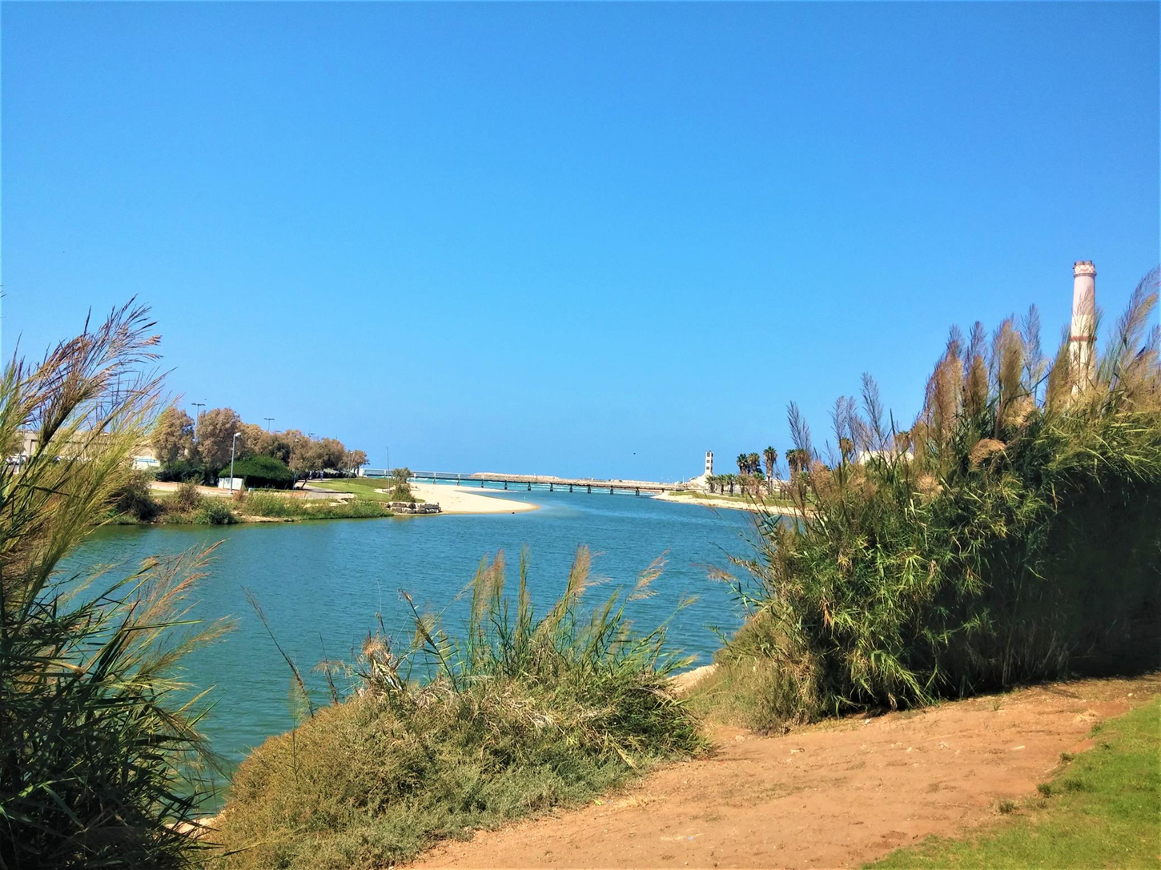
Research Project 7th grade students - Marine Science class Ironi Hei High School, Tel Aviv
Water Properties of the Estuary of the Yarkon River
Marine Science Teacher:
Dr. Hava Contini
March 2022

Slide 2
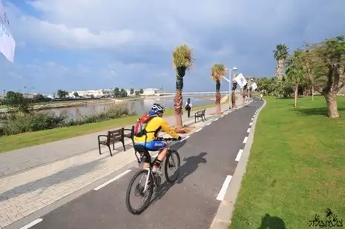
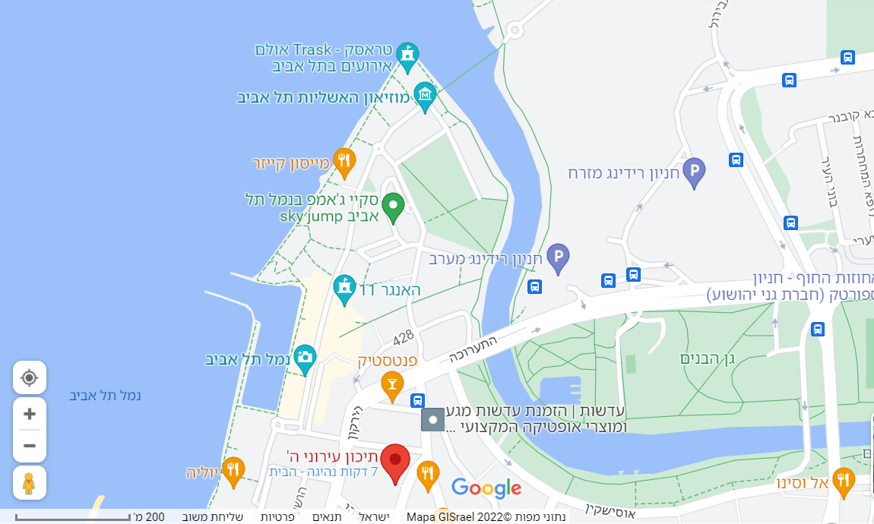
Our school is very close to the Yarkon river and its estuary
Most of the school students, like many people from Tel Aviv and its surroundings, spend leisure time with family and friends on both sides of the river. There are sport activities, playgrounds, dog parks, as well as the Israel Trail for walking and biking along the river.

Slide 3
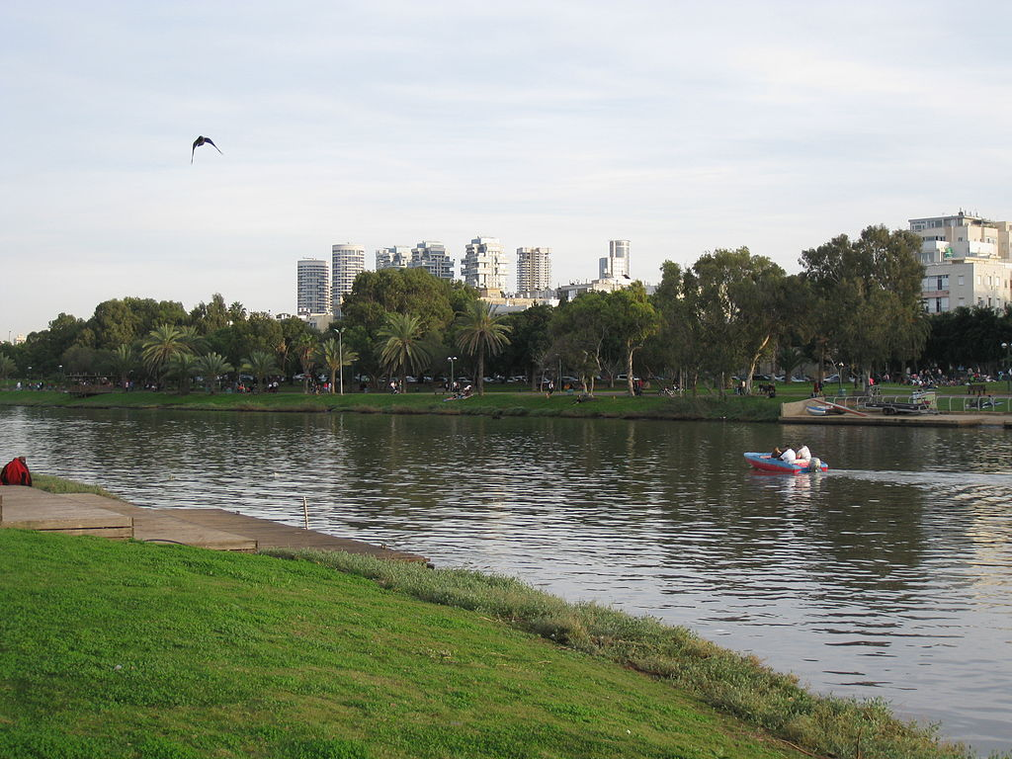
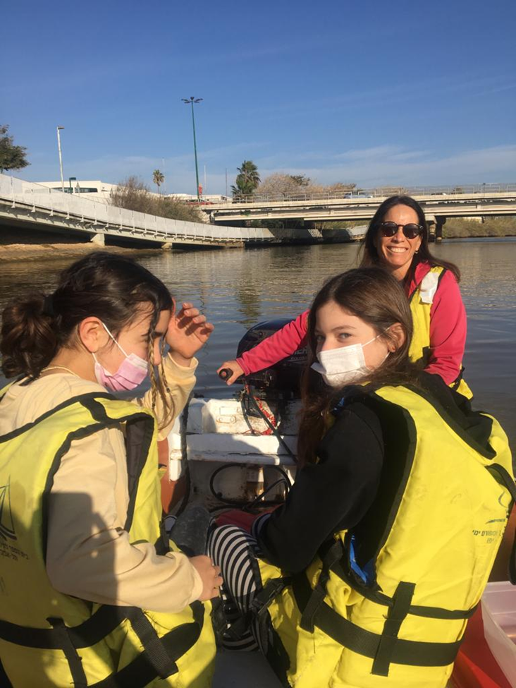
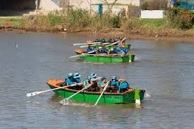
Being part of the Marine Science class, we go once a week to the Daniel Rowing Center on the Yarkon River and study how to sail.

Slide 4
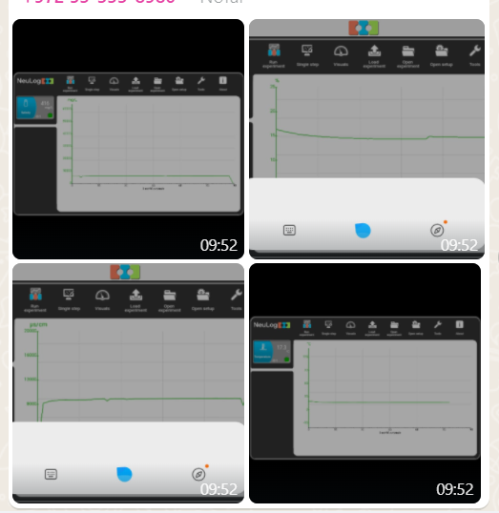
We monitor the water using NeuLog sensors. They are easy to use, and the results instantly appear on our mobile phones.
The results are then uploaded to an Excel sheet.

Slide 5
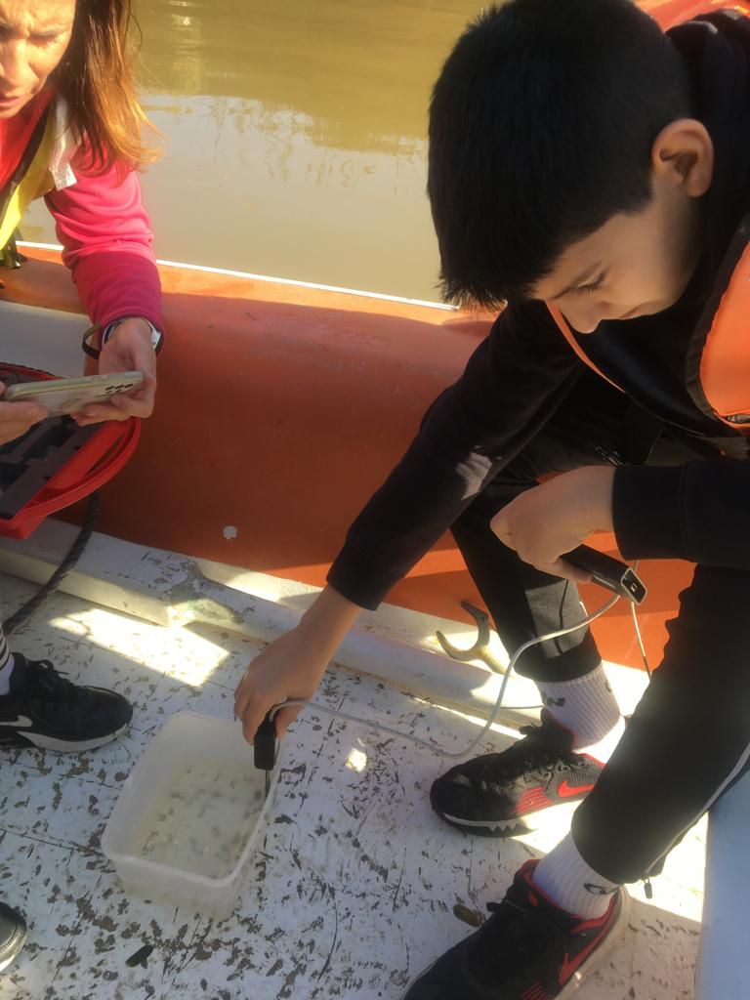
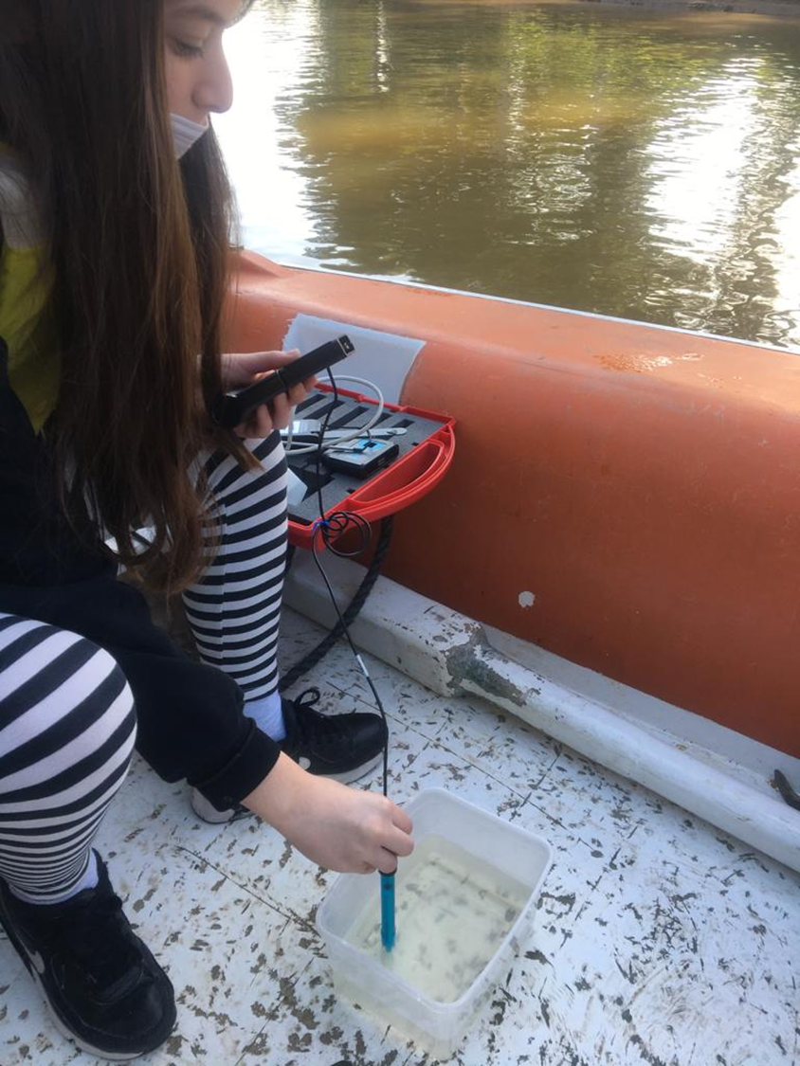
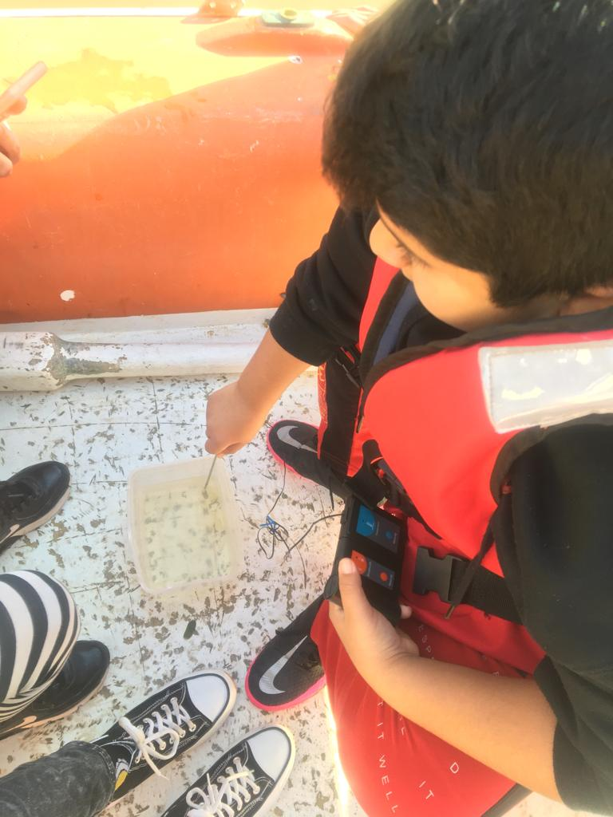
The properties that we checked are salinity, pH, dissolved oxygen, temperature and turbidity.

Slide 6
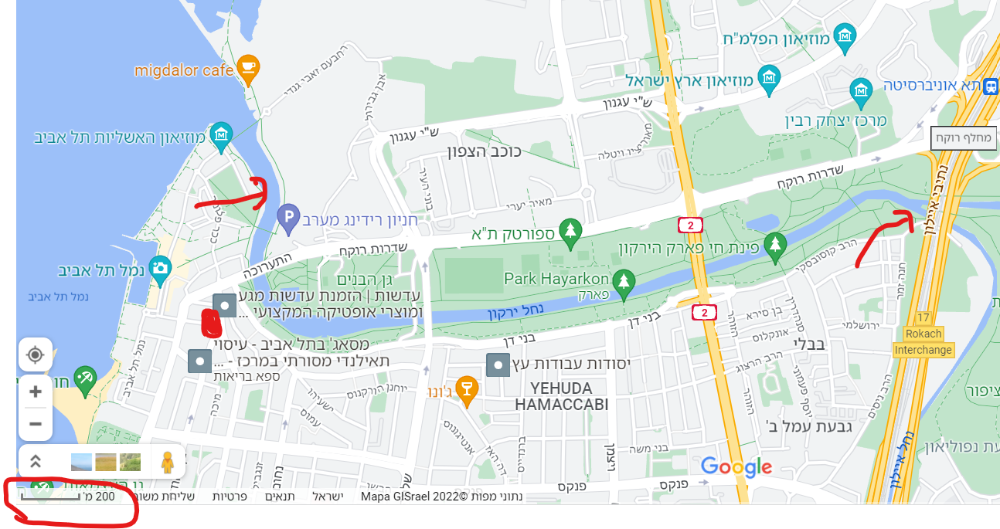
We checked the properties of the water in two locations:
at the mouth of the estuary and before the Ayalon river splits from the estuary, about 1.5 km further up the river.

Slide 7
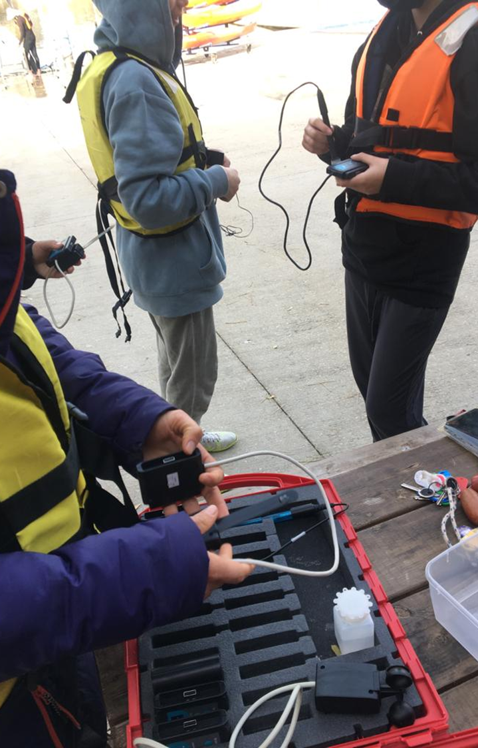
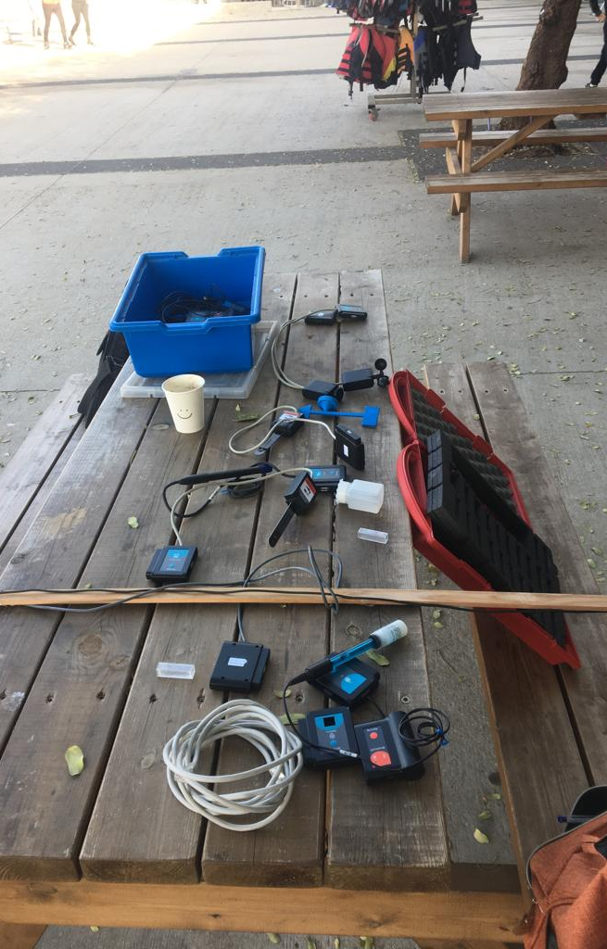
When we started to take part in the research project , we understood the importance of monitoring the water properties and their changes in the different locations and seasons.

Slide 8
What have we got from this project so far?
We have seen locations along the river that we did not know before, water birds and plants.
We have learnt about sensors and their technology.
We have had fun sailing.
We have learnt about security measures for sailing
We have contributed to estuary research, and hopefully to the rehabilitation of the river.

Slide 9
We will go on with monitoring the water properties to see if there are differences between the two monitoring locations, and between winter and summer.

Slide 10
Sabi from Tel Aviv Municipality
The staff of the Tel Aviv-Yafo Daniel Rowing Center Marine Education School
Mr. Arye Nahum, SES
Mr. Adi Lak
Hi-Teach
Rotary Tel Aviv
Thank you to:

